Slide 1

Neural Style Transfer
Content cost function
deeplearning.ai

Slide 2
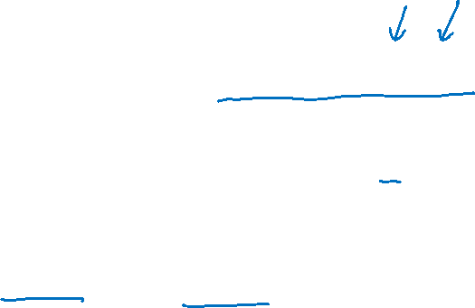
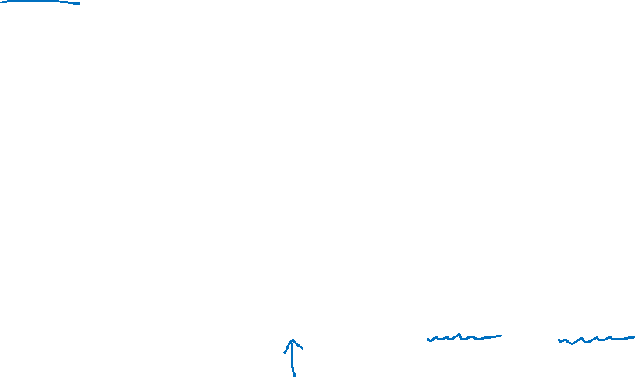
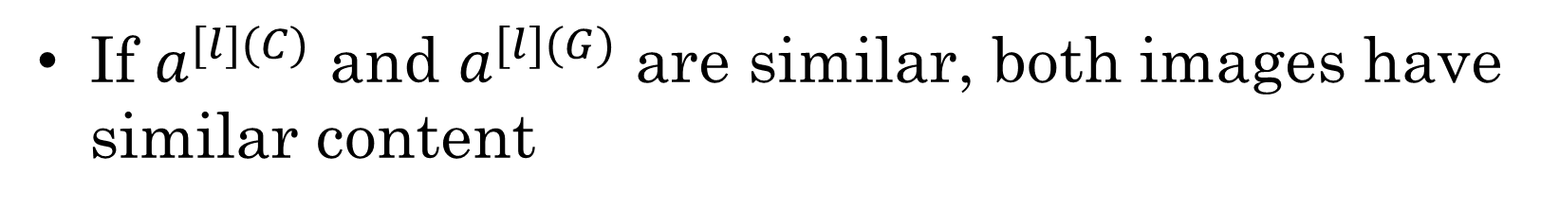
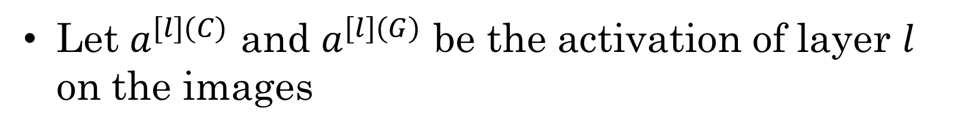
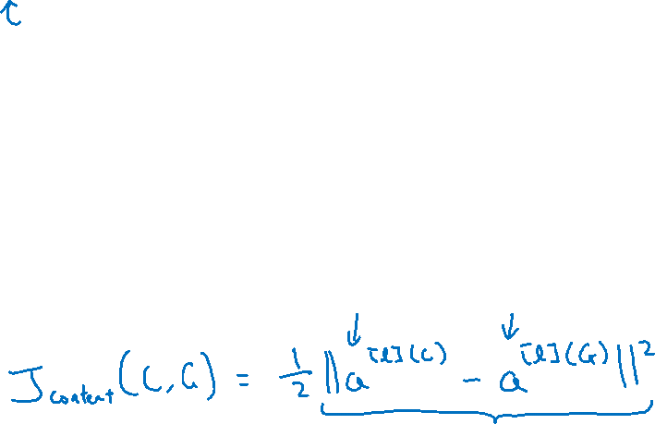
Content cost function
$$J\left(G\right)=α J_{content}\left(C,G\right)+β J_{style }(S,G)$$
Say you use hidden layer $l$ to compute content cost.
Use pre-trained ConvNet. (E.g., VGG network)
Let $a^{[l](C)}$ and $a^{[l](G)}$ be the activation of layer $l$ on the images
If $a^{[l](C)}$ and $a^{[l](G)}$ are similar, both images have similar content
[Gatys et al., 2015. A neural algorithm of artistic style]

